Slide 1
Retinopathy Of
Prematurity
Dr Amir Eftekhari
Assistant Professor of Ophthalmology
Nikookary eye center

Slide 2
Historty
Was first described in 1942 and quickly became the primary cause of childhood blindness throughout the developed world.
From retrolental fibroplasia to ROP
The discovery of the relationship between supplementary oxygen and ROP in 1950 led to rigid curtailment of oxygen supplementation in the nursery, and a dramatic decrease

Slide 3
Retrolental fibroplasia

Slide 4
Pathophysiology of ROP
Normally retinal vascularization proceeds from the optic disc to the periphery , begins at week 16 of gestation , and is completed nasally by 36 weeks of gestation , and temporally by 40 weeks gestation .
The pathophysiology of ROP has 2 phase process :
1 – Cessation of normal retinal vasculature : decrease the level of VEGF and IGF-1
2- the second phase begins at 31-34 weeks postconseptional age : abundance of VEGF and IGF-1 secreted by ischemic retina as well as by the oxidative damage to endothelial cells , which leads to disorganized vascular growth .

Slide 5
Risk factors
Oxygen supplementation
Short gestational period
Iow birth weight
Genetic predisposition
Intercurrent illness
Blood transfusion
Pco2
Weight gain
Systemic IGF-1 level

Slide 6
Prevalence
Based on 1993 World Health Organization estimates,over 50,000 children are blind from ROP worldwide, with many more with unilateral loss of vision or visual impairment .
In the United States, the incidence of ROP was estimated in the Early Treatment for Retinopathy of Prematurity (ETROP) study to be 68% among infants of <1,251 g, similar to the results seen in the Cryotherapy for Retinopathy of Prematurity (CRYOROP) study, conducted 15 years earlier .
The incidence of ROP increases with decreasing birth weight and has been reported to be 33.2% for infants with birth weight <1,000 g in recent literature, much lower than in the ETROP and CRYO-ROP studies . This may represent a true decrease in the incidence of disease or simply be a reflection of the differences in the methodology of the studies (prospective vs. retrospective).

Slide 7
International Classification of ROP
Zone : 1 , 2, 3
Stage : 1 ; 2 ; 3 ; 4A ; 4B ; 5
Extent of stage
Persence of plus disease

Slide 8
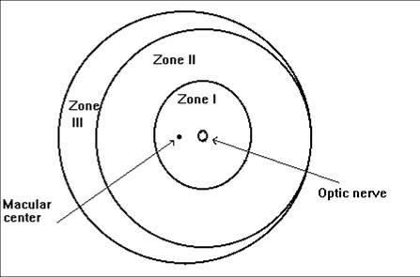

Slide 9
Staging of ROP
Stage 1 : A line is apparent between vascular and avascular retina
Stage 2 : there is a ridge having obvious volume
Stage 3 : There is neovascularization growing on to the vitreous at the ridge
Stage 4 : there is partial retinal detachment ; 4A without macular involvement and 4B with macular involvement
Stage 5 : total retinal detachment and is described as close or open

Slide 10
Plus disease
Plus disease refers to dilation and tortuosity of the retinal arterioles and veins in the posterior pole and is based on a standard photograph published in the multicenter trial of CRYO-ROP .
In later clinical trials, the definition of plus disease was modified so that the diagnosis of plus disease could be made if sufficient vascular dilation and tortuosity were present in at least two quadrants .
Pre–plus disease was defined as abnormal dilation and tortuosity of the posterior pole vessels, which is insufficient for the diagnosis of plus disease based on the standard photograph but is more so than normal .

Slide 11
Aggressive posterior ROP
Aggressive posterior ROP (AP-ROP) was defined as aggressive posterior retinopathy observed commonly in zone I or posterior zone II, with dilation and tortuosity of both arteries and veins in all four quadrants that is out of proportion to the peripheral retinopathy. AP-ROP does not usually progress through the classic stages, extends circumferentially, and can be accompanied by a circumferential vessel. Though there may only be a flat neovascularization at the junction of vascularized and nonvascularized retina, this aggressive form of ROP usually progressed to stage 5 if it is not promptly treated .

Slide 12
Stage 1

Slide 13
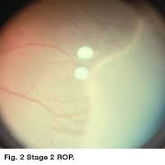
Stage 2

Slide 14
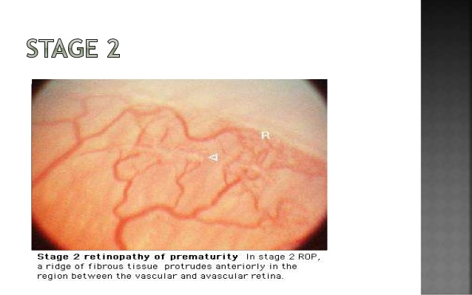
Stage 2

Slide 15
Stage 2

Slide 16
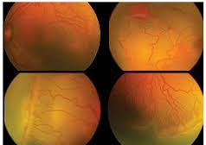
Stage 3

Slide 17
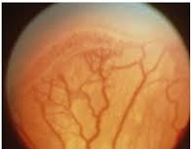
Stage 3

Slide 18
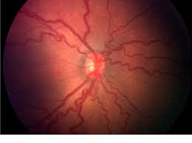
Plus disease

Slide 19
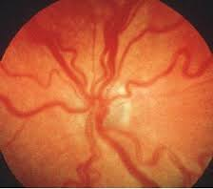
Plus disease

Slide 21
Definitions of prethreshold and threshold ROP
Prethreshold ROP
Zone I, any stage
Zone II, stage 2 with plus disease
Zone II, stage 3 less than threshold
Prethreshold classification used for ETROP trial
Type 1 (high-risk prethreshold where risk of unfavorable outcome is ≥15%)
Zone I, any stage with plus disease
Zone I, stage 3 without plus disease
Zone II, stage 2 or 3 with plus disease
Type 2 (low-risk prethreshold ROP where risk of unfavorable outcome is <15%)
Zone I, stage 1 or 2 without plus disease
Zone II, stage 3 without plus disease
Threshold ROP
Zone I or II, stage 3 (five contiguous or eight total clock hours) with plus disease

Slide 22
Age of onset
Most infants that develop some form of ROP do so at about 32 weeks’ postmenstrual age (PMA). PMA equals gestational age plus age after birth in weeks .
Threshold disease, at which the risk of a poor outcome approached 50% , peaks at approximately 37 weeks’ PMA and high-risk prethreshold ROP , where risk of a poor outcome is ≥15%, at approximately 35 weeks
Eyes that rapidly progress to prethreshold ROP have a greater risk of developing threshold ROP and will develop threshold disease at an earlier PMA.
When infants achieve 45 weeks’ PMA without developing prethreshold ROP, they have a low risk of developing threshold ROP or of having a poor outcome

Slide 23
Time of screening
The first examination should generally be performed :
Between 4-6 weeks of postnatal age or
Between 31 -33 weeks post menstrual age
Whichever is later

Slide 24
Follow up time
1 week or less :
Immature vascularization in zone 1 – no ROP
Immature retina extends into posterior zone 2 ; near the boundary of zone 1
Stage 1 or 2 ROP in zone 1
Stage 3 ROP in zone 2
The presence or suspected presence of aggressive posterior ROP

Slide 25
Follow up time
1-2 weeks
Immature vascularization in posterior of zone 2
Stage 2 ROP in zone 2
Unequivocally regressing ROP in zone 1
2 weeks
Stage 1 ROP in zone 2
Immature vascularization in zone 2 – no ROP
Unequivocally regressing ROP in zone 2

Slide 26
Follow up time
2-3 week
Stage 1 or 2 ROP in zone 3
regressing ROP in zone 3
When can retinal examination be discontinued ?

Slide 27
Criteria for screening
American academy of pediatric : all infants with birth weight of less than 1500 gr or gestational age of 30 weeks or less
In IRAN
All infants with birth weight of less than 2000 gr or gestational age of 34 weeks or less
WINROP algorithm : systemic IGF -1 level and weight gain

Slide 28
Discontinution of retinal screening exam
Full retinal vascularization in close proximity to the oraserrate for 360
Zone 3 retinal vascularization attained without pervious zone 1 or 2 ROP
Postmenstrual age of 50 weeks and no prethreshold disease or worse ROP is present
Regression of ROP

Slide 29
Course of ROP
Most ROP regresses; however, the disease typically progresses before regressing and this progression can be rapid—in the ETROP study, in infants born weighing <1,251 g, 22% of infants with type 2 prethreshold ROP progressed to type 1 prethreshold and half of these in <7 days .
In about 6% of infants born weighing <1,251 g, threshold ROP develops . Without treatment, this results in an unfavorable outcome in about 52% of eyes at 15-year followup
In the CRYO-ROP trial, approximately 30% of eyes experienced an unfavorable anatomic outcome even after treatment for threshold ROP . Unfavorable visual outcomes were 45% for treated eyes and 64% for untreated eyes, respectively .
However, based on outcome data from the ETROP trial, treatment at a less severe level of ROP, that is, for type 1 prethreshold ROP (type 1 ROP), reduces poor visual and functional outcomes compared to waiting until threshold ROP develops

Slide 30
Differential dignosis
Familial exudative vitreoretinopathy
Norrie disease
Incontinentia pigmenti
Congenital retinal fold
Toxocara canis infection
Causes of leukocoria

Slide 31
Treatment
Crayotherapy of avascular retina
Lasertherapy of avascular retina
Anti-VEGF treatment
Surgery : scleral band
deep vitrectomy

Slide 32
TREATMENT
Cryotherapy for ROP : 1988
ETROP : laser ablation treatment of avascular retina in type 1 and threshold ROP
Beat ROP study : compared with conventional laser therapy ; a stastically significant treatment benefit for bevacizumab was demonstrated for zone 1 ROP ; where as zone 2 ROP had similar outcomes with either treatment .

Slide 33
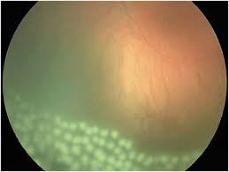

Slide 34
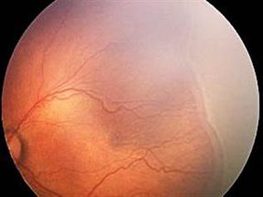

Slide 35
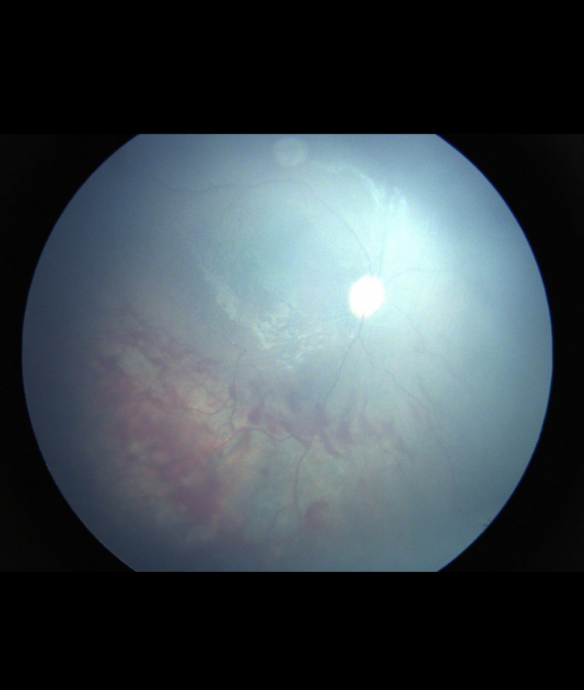
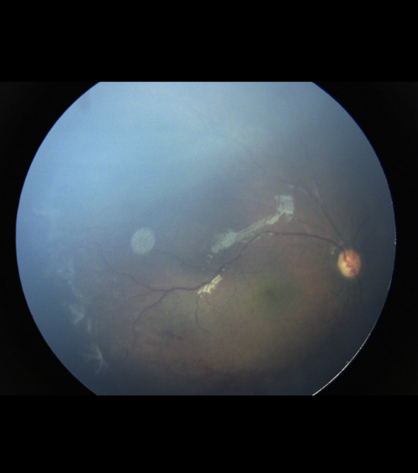

Slide 36
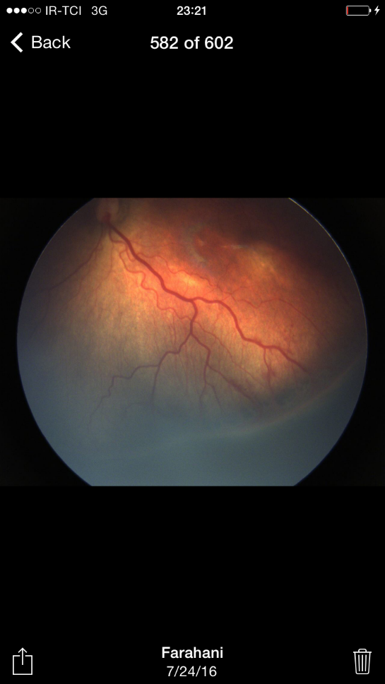
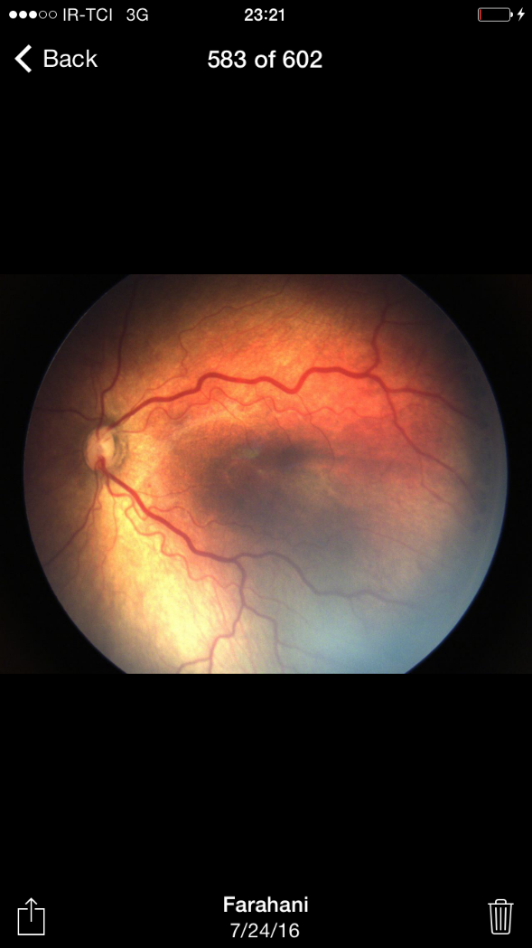

Slide 37
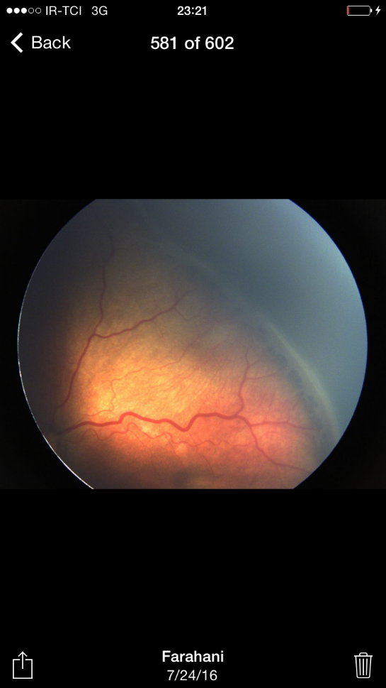
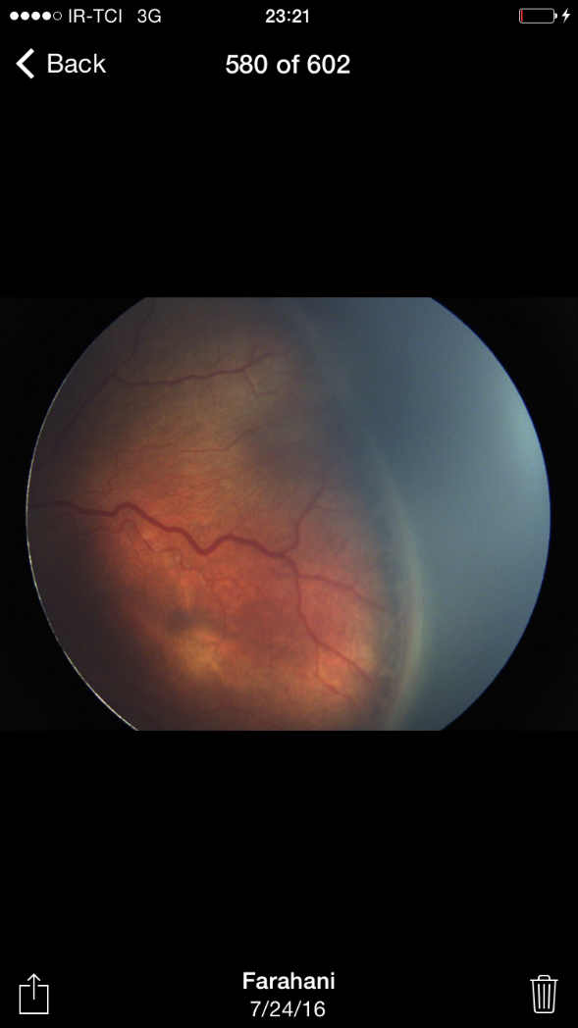

Slide 38
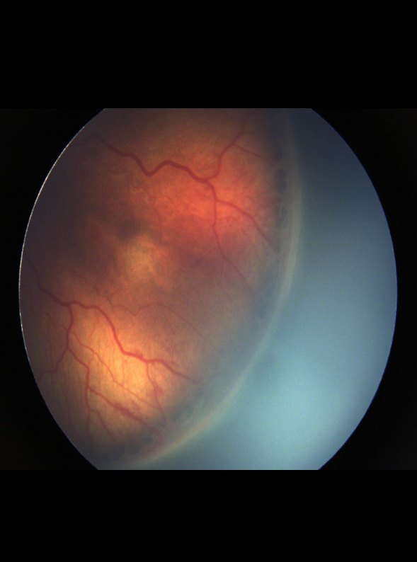
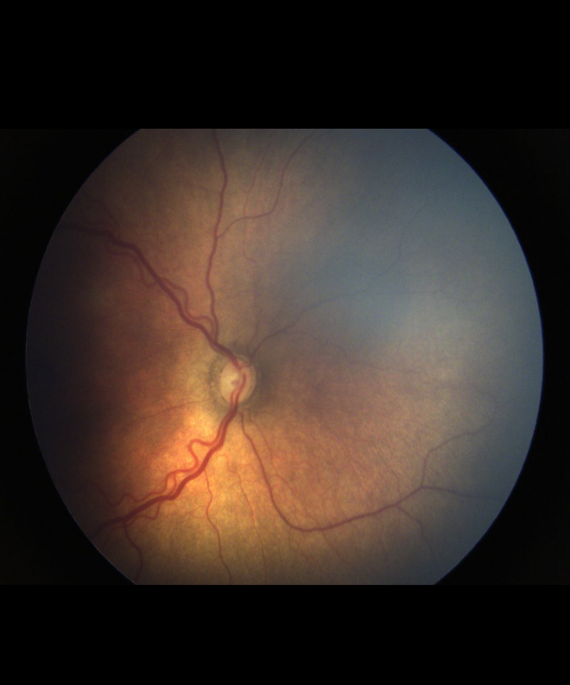

Slide 39
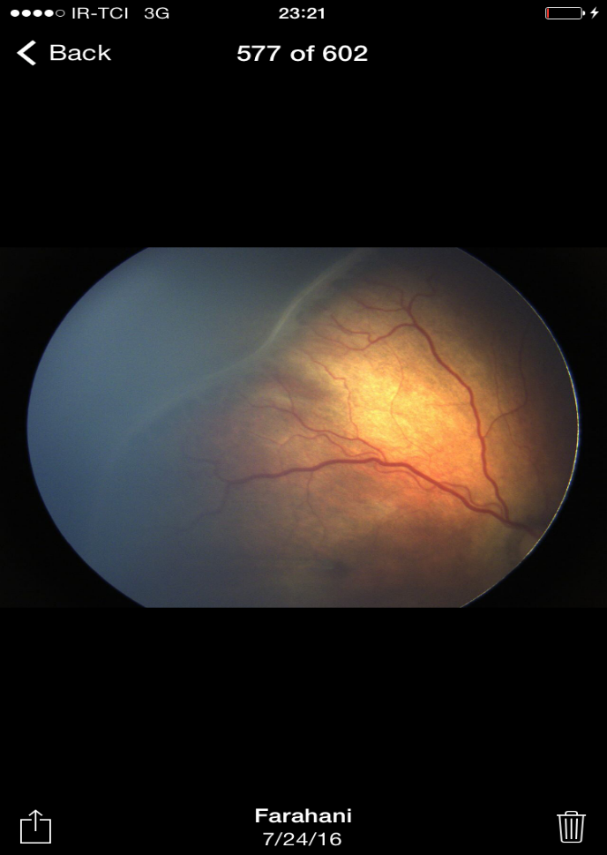

Slide 40
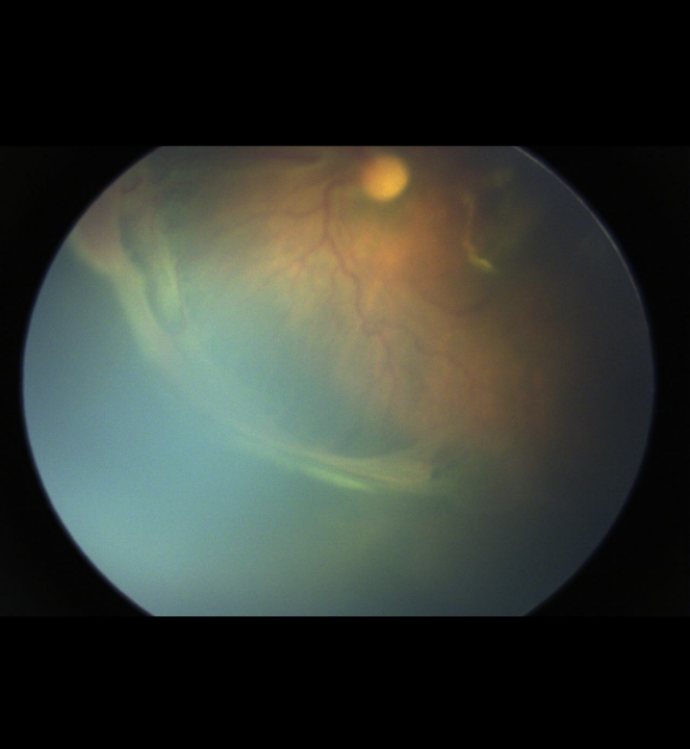
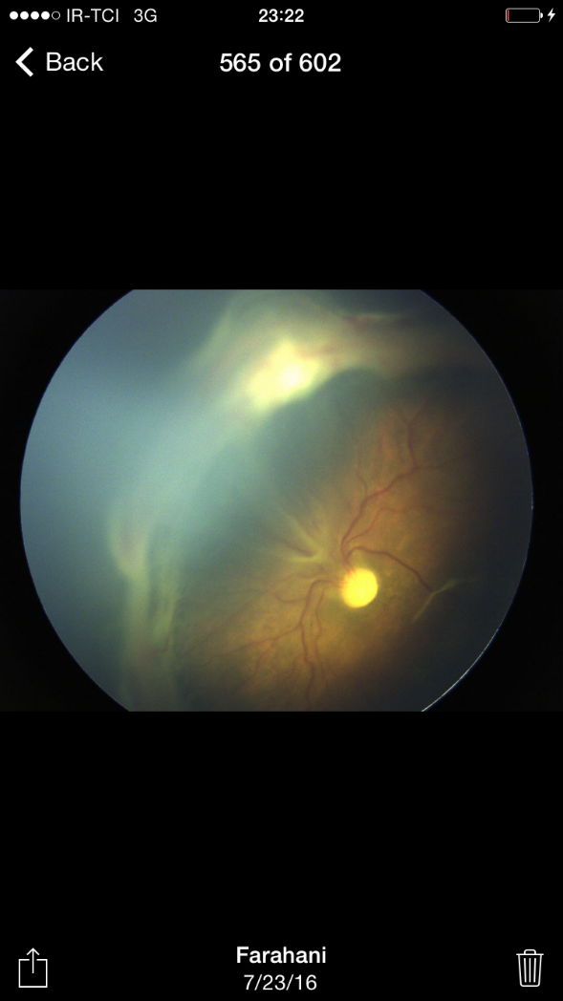

Slide 41
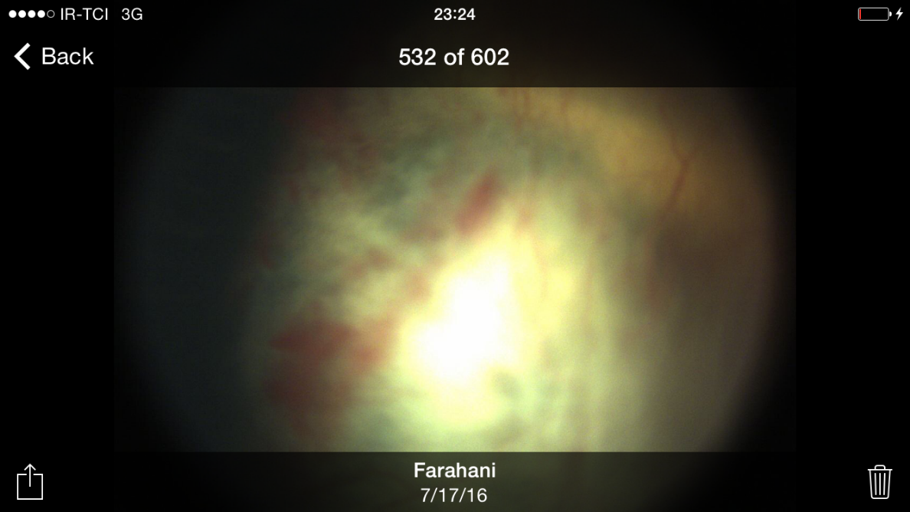
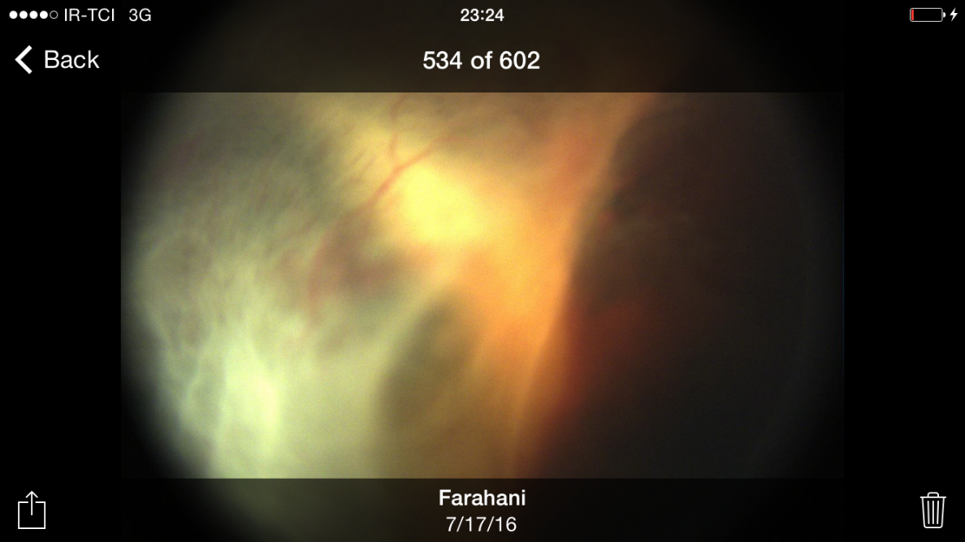

Slide 42
